Slide 1

Modular Golf Kit
By:
Zair Chaudhry, Daecheol Jeong,
Muhammad Ijlal, Ralph Estephan, David Yi

Slide 2


Problem Statement
Need a new solution to buying golf clubs online.
Clubs are custom fitting, to player’s swing
Could be a hardware solution
Could be a software solution
An end-to-end user experience process
Needs a technical and experiential solution

Slide 3
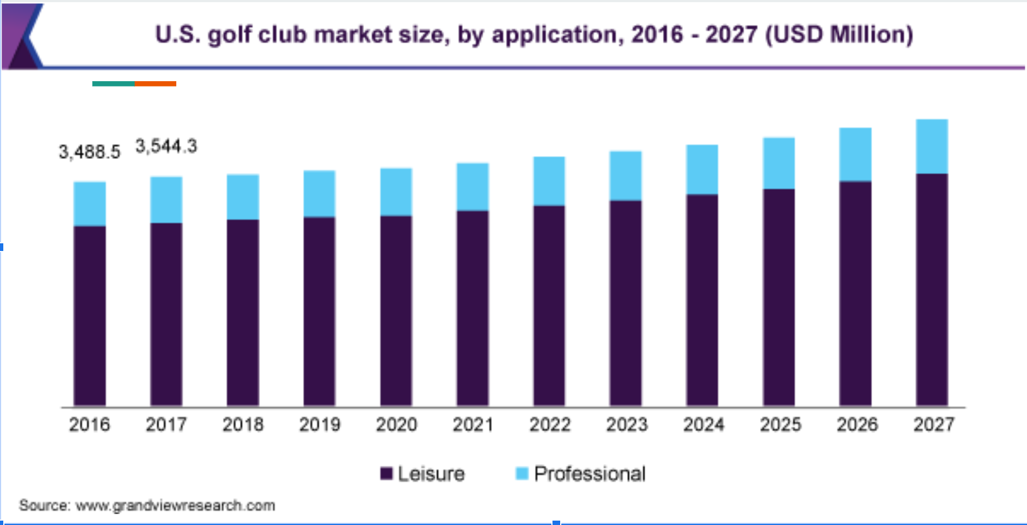
Target Audience
70-80% of market are Leisure Players.
Leisure Players Make $100,00 Income (Average)
Feeling overwhelmed / frustrated about Learning Golf/ Customizing Gear.

Slide 4
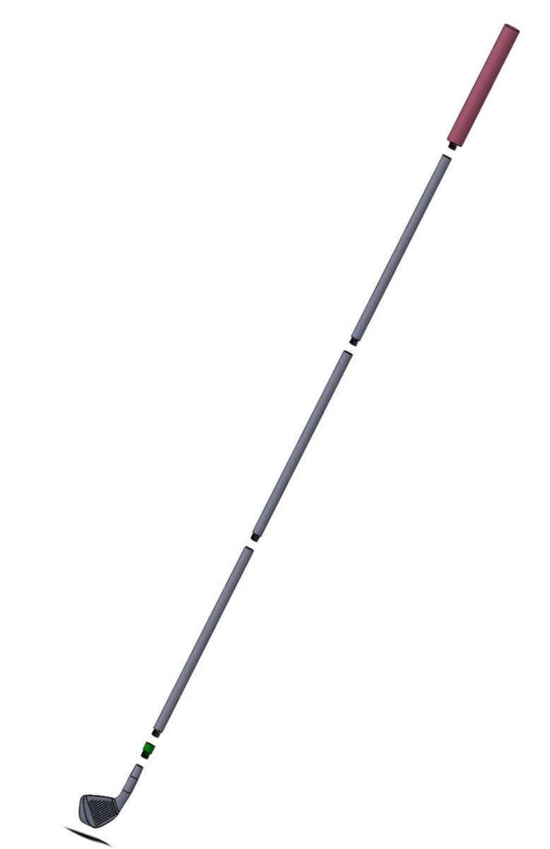
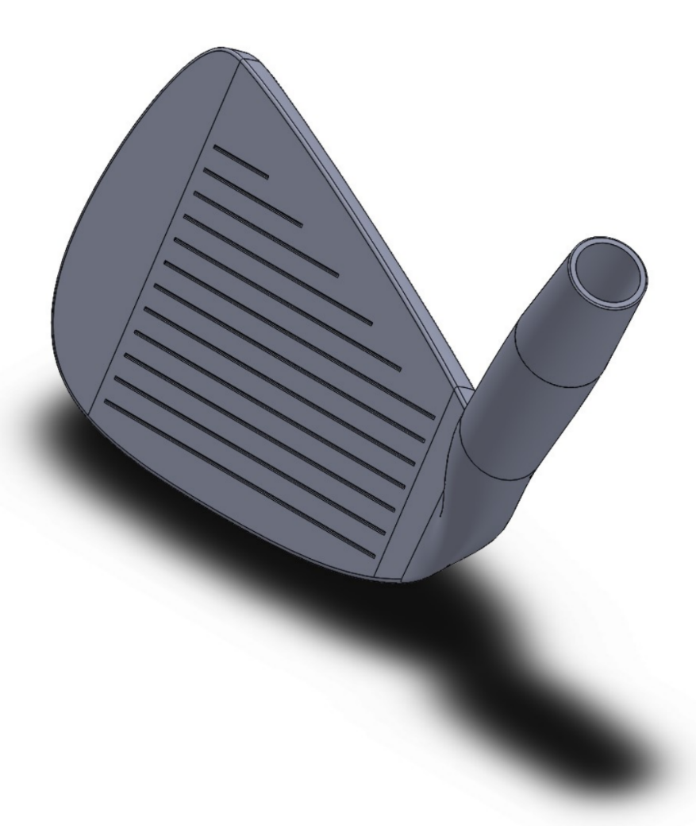

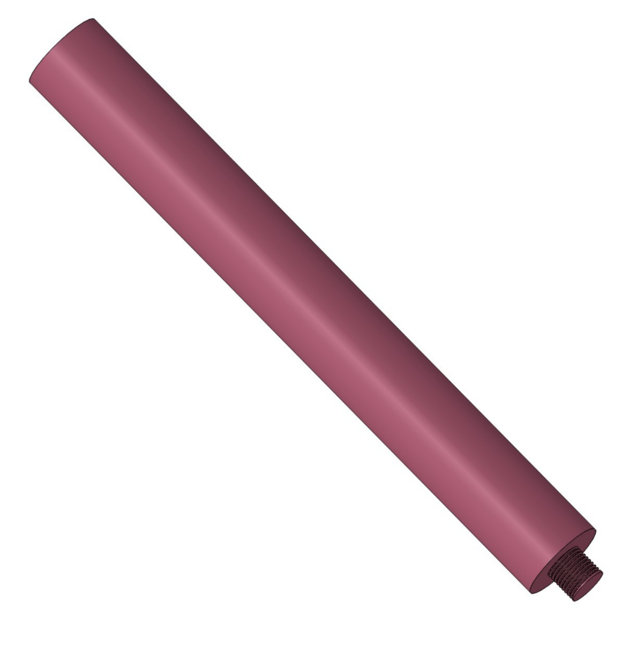
Prototype
Modular Golf Kit
Swappable Handle, Shaft, and Head
User takes questionnaire to finds appropriate fitments.
AI recommends parts

Slide 5
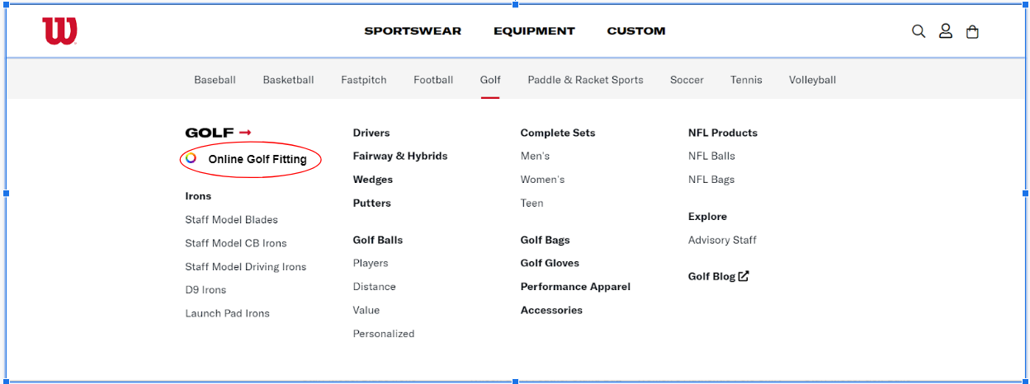
Website

Slide 6
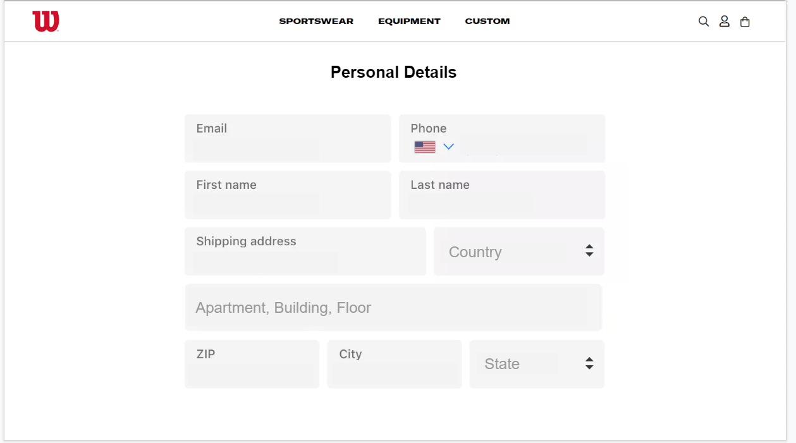
Account Information

Slide 7
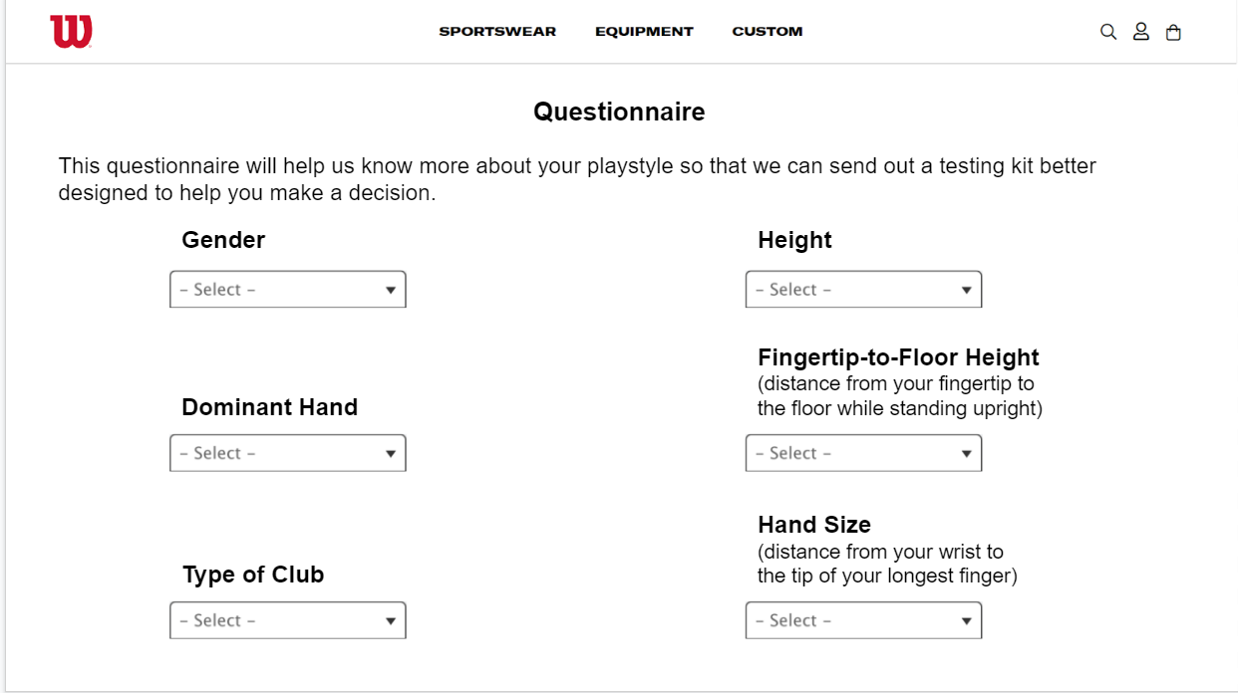
Fitting Questionnaire

Slide 8
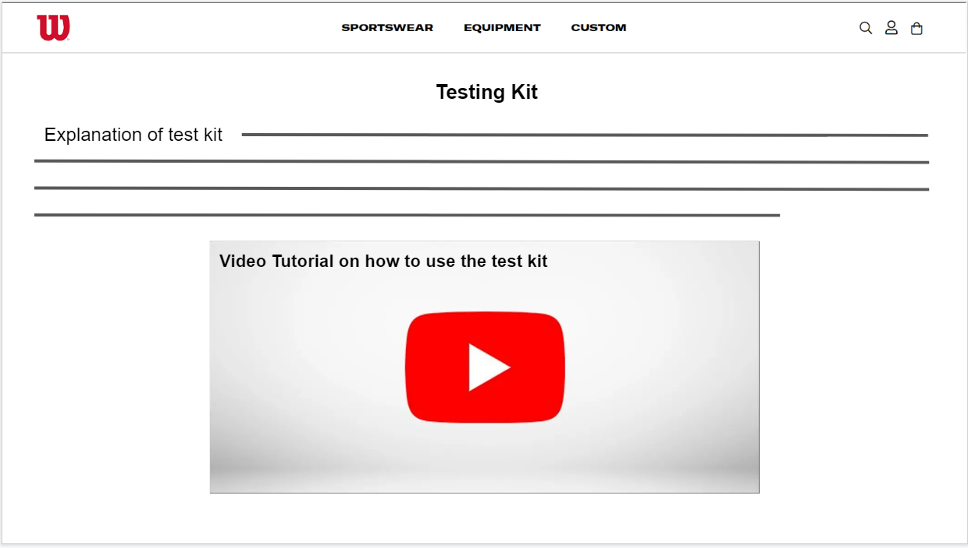
Video Support

Slide 9
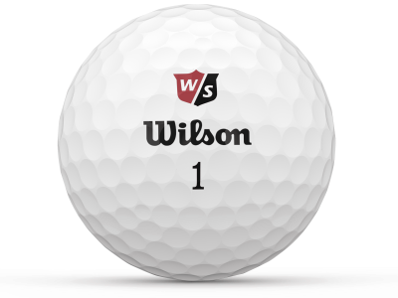
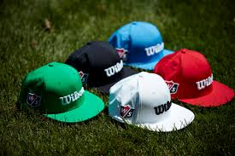
Marketing & Promotion
Test Kit can be Sponsor Golfer Influencers
Social Media Sponsorships
YouTube, Twitter,Instagram
Test Kit will be Sold as Monthly Subscription
Free Stickers, Balls, Hats with purchase

Slide 10
THANK YOU SO MUCH
FOR YOUR TIME

